Slide 1
Notes:
Welcome to the Arctic
Tromsø is Norway’s seventh largest city. Most of Tromsø, including the city center, is located on the island of Tromsøya. The city is surrounded by spectacular mountains and fjords, 350 kilometers north of the Arctic Circle. Owing to the warming effect of the Gulf Stream, Tromsø is milder than most other places located on the same latitude.

Slide 2
Notes:
Today, Tromsø is the capital of Norway’s high north, the home of 70.000 lively inhabitants living on the edge of the Arctic. The city is situated right between islands, fantastic fjords and dramatic mountain peaks.
Situated at 69 degrees north, only 2000 km from the North Pole, visitors are amazed when learning that our city has hotels with international standard, busy cafés, restaurants with world class seafood, an active cultural life, a very active night life and captivating museums and art galleries.
Over the years, feedback from visitors describes the arctic adventure in Tromsø as a warm, exciting life-time memory.

Slide 7
Notes:
Summer Tromsø – experiences in the Midnight Sun!
The situation above the Arctic Circle means Tromsø enjoys the Midnight Sun from May 20 to July 15 when the sun doesn`t set below the horizon.

Slide 9
Notes:
Playing golf in the Midnight Sun on our own 18-hole golf course is in itself a distinctive hole-in-one.
Tromsø Golf course is situated 45 minutes by bus from Tromsø.

Slide 11
Notes:
Enjoy a midnight concert in the Arctic Cathedral. Tromsø’s architectural landmark shines like a lighthouse in the Polar Night and sparkles in the Midnight Sun. The Arctic Cathedral was inspired by icebergs, fish racks and Sami tents, and sports the biggest stained glass window in Europe. Its organ is incredibly powerful and is shaped like the sails of a ship.

Slide 17
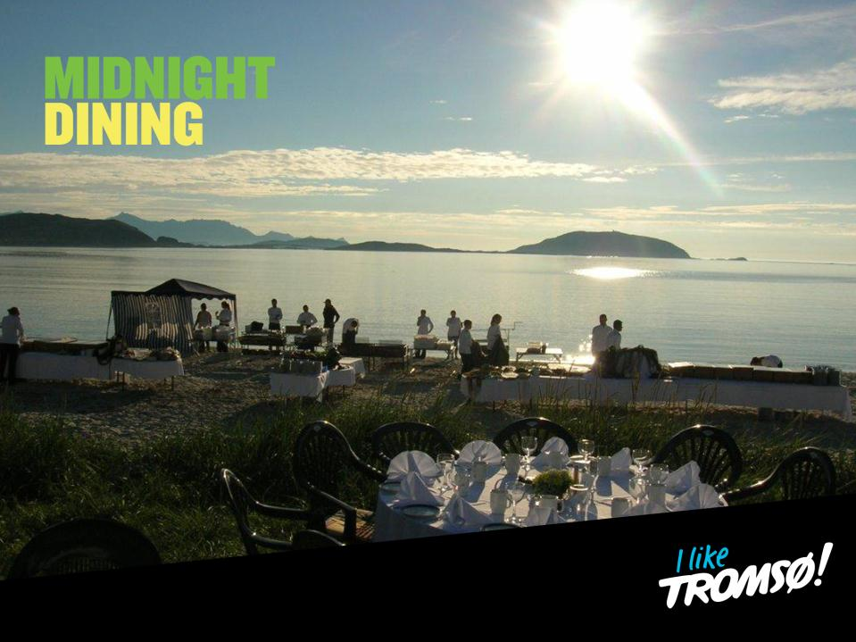
Notes:
A special outdoor dining

Slide 18
Notes:
Polar Nights: from November 21st to January 21st the sun disappear under the horizon and we experience the polar nights

Slide 19
Notes:
Dine around Tromsø has Norway`s highest density of bars, cafes and restaurants, with seats sufficient to serve one third of the Tromsø population at the same time. All the restaurants and nightclubs are located in the city center, and within walking distance from the hotels. The restaurants in Tromsø can offer local and fresh ingredients prepared with experience and care. Menus are inspired by both Norwegian traditions and international influence - made with ambitions to inspire and excite their guests.
Be inspired with the taste of Northern Norway

Slide 20
Notes:
Experience the northernmost brewery in the world.

Slide 21
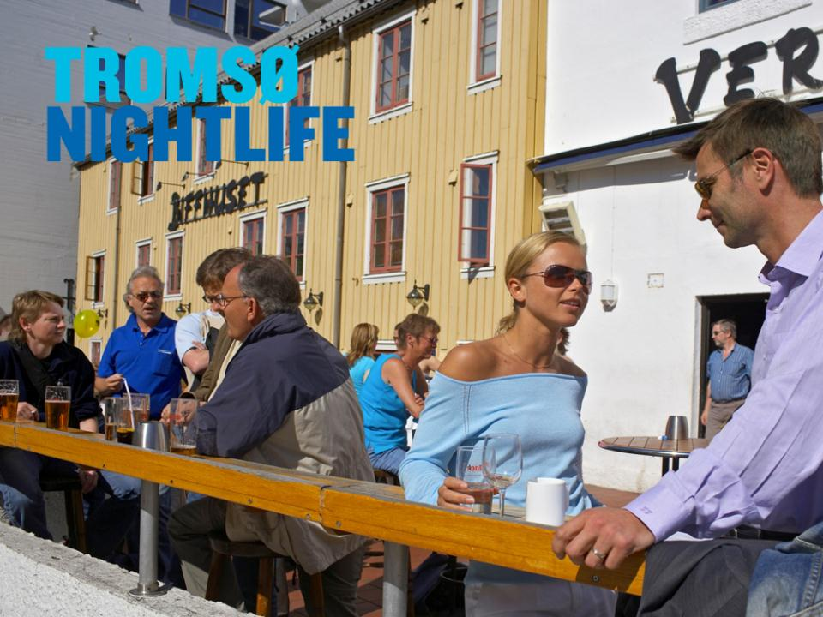

Slide 22
Notes:
Be part of the story
Visiting Tromsø is like coming home, even if you have never been here before. As a destination, Tromsø is packed with polar history from Nansen and Amundsen, the world’s northernmost brewery and architectural masterpieces like the Arctic Cathedral and the public library, to mention but a few. Groups and individuals alike enjoy the numerous activities and organized tours available on a daily basis – as well as the vibrant cultural scene with music, art and theatre to inspire and provoke your senses.

Slide 23
Notes:
Travel up to Mount Storsteinen by the Cable Car for a welcome champagne at dizzy heights. At 421 metres above sea level you will be overlooking the city of Tromsø and the breathtaking view of the fjords and mountains surrounding the town.

Slide 24
Notes:
Pure pleasure!

Slide 25
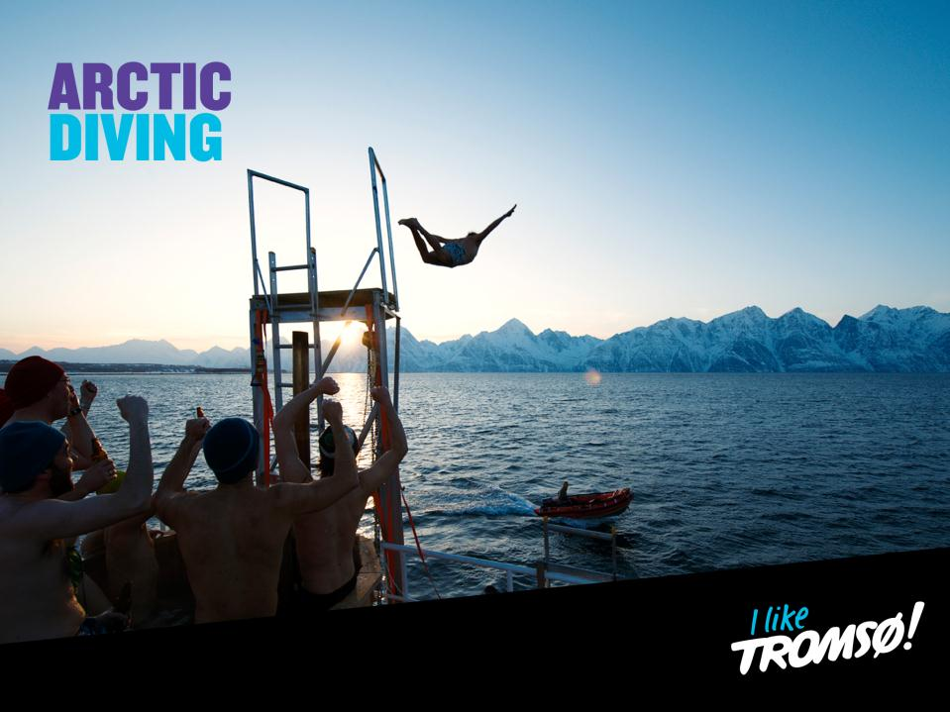
Notes:
Arctic experience! A life-time memory.

Slide 26
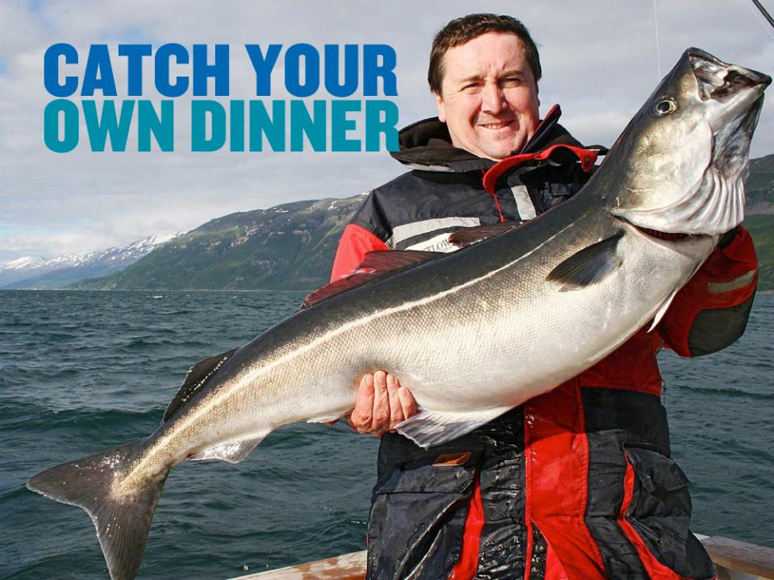
Notes:
Why not try Arctic Deep Sea Fishing Competition right outside Tromsø. Guests will be equipped with fishing gear before you leave for the seas in an old vessel. An introduction to this fishing adventure will be given of one of Norway’s best fishing guides.

Slide 27
Notes:
Visit Mack’s brewery which was founded in 1877 and is the oldest pub in Tromsø. It is also the world’s northernmost brewery. Guests will be given a guided tour of the brewery. Visit ends with taste of local beer.
Tromsø is also the home to the world’s northernmost
University
Beer brewery
Cathedral
Glass blowing hut
Botanical Garden

Slide 29
Notes:
In summer hikers can choose between the easily accessible coastal range and the more challenging Alps at Senja. Canoeing on tranquil forest rivers, wild bike rides down hillsides, kayaking on blank fjords or on the open sea, fishing trips late at night; the light makes you lively and energetic.

Slide 30
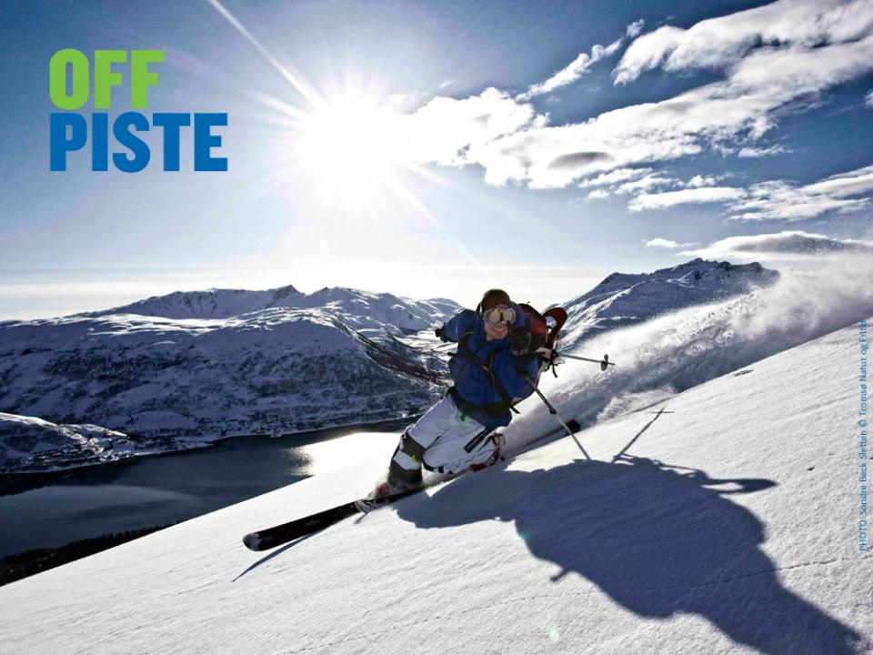
Notes:
For those seeking off-piste Adventures, Senja has lots to offer. The area is very popular among extreme skiers, but there are mountains suitable for intermediate back-country skiers too.

Slide 32
Notes:
Enjoy a reindeer sleigh ride through beautiful landscape passing majestic mountain peaks, valleys and deep blue fjords in Tamokdalen. Guests will be given an introduction to the Sami culture and lunch is served inside a traditional Saami tent lavvu.

Slide 33
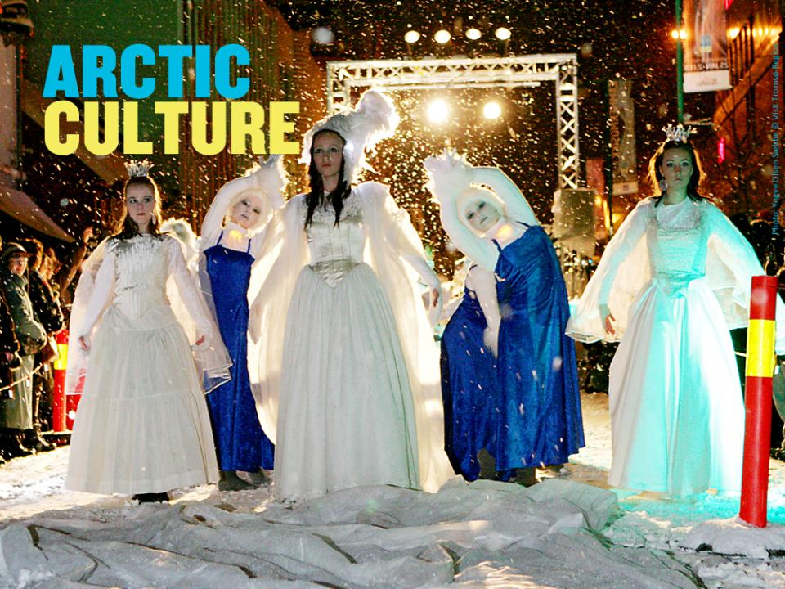
Notes:
Attend the Tromsø International Film Festival or Northern Lights Festival, both arranged in January.

Slide 34
Notes:
Try dog sledding under the Northern Lights! Drive a team of dogs yourself or ride on a sledge covered with warm reindeer skins and driven by an expert guide.

Slide 35
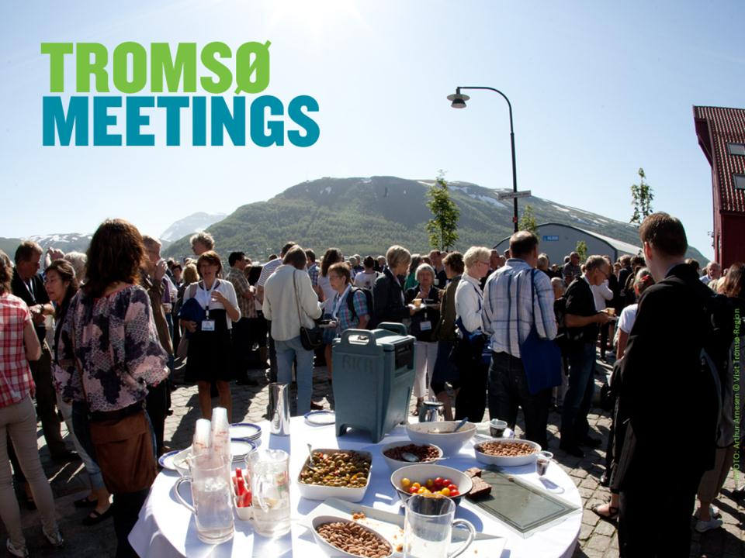
Notes:
A different meeting
Tromsø has for many years enjoyed a well-earned reputation as an excellent host city for conferences. The city’s hotels enjoy a high level of co-operation and, given the city’s compact nature, it is easy to host conference delegates at a mix of hotels.
Tromsø is also an ideal place to add a social dimension with enjoyable, challenging, interesting and education activities, with a choice of everything from dog sledding or church concerts to boat trips. Competitive air travel and hotel prices in recent years have contributed to making Tromsø even more accessible. Experience shows that meetings or conferences hosted in the popular city of Tromsø attract a high attendance rate.

Slide 37
Notes:
Spectacular city for meetings!

